Slide 1
System Programming MP0
github register

Slide 2
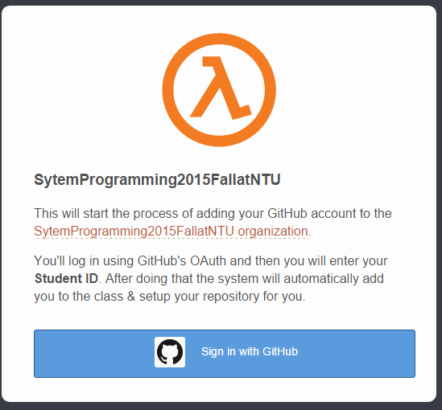
step.1
http://140.112.28.114:4000/
click it

Slide 3
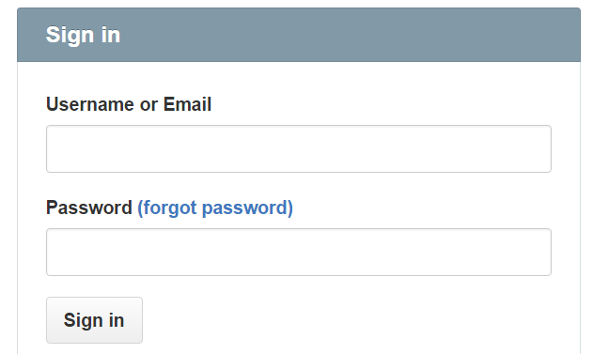
step.2
sign in your github account

Slide 4
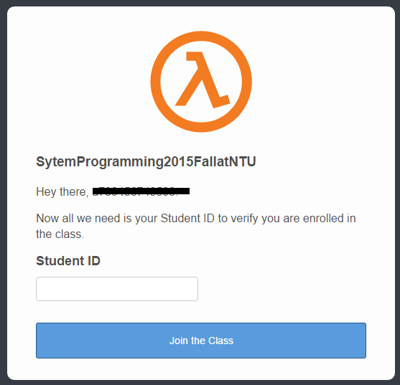
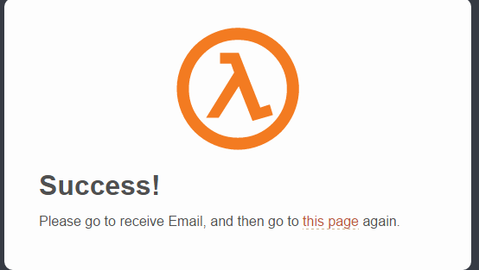
step.3
input your Student ID

Slide 5
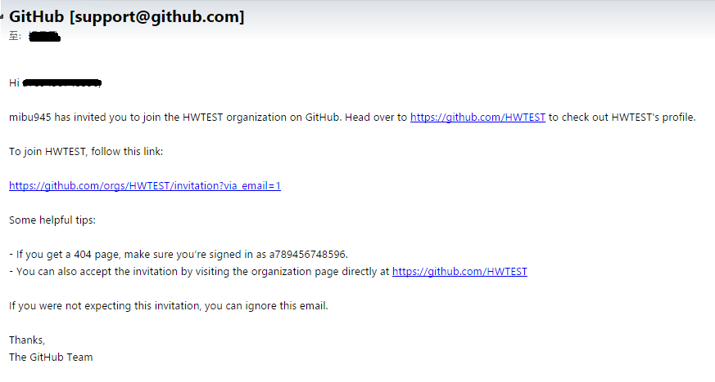
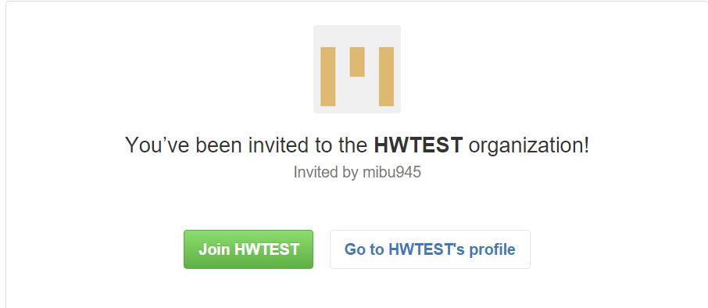
step.4
go to your github email
click it

Slide 6
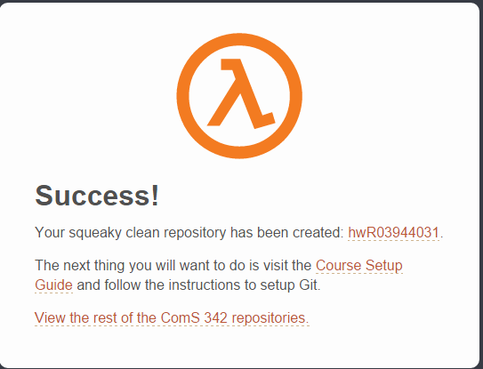
step.5
go to http://140.112.28.114:4000/ again.
2. redo step.1~ step.3

Slide 7
finish
your repository

Slide 8
Acknowledgement
楊昌民 to prepare the slide deck.
The scripts to add enrolled students and create private repository were revised from the code developed by .
Original source:

